Slide 1
Notes:
Begin by:
Welcoming attendees to the meeting
Thanking them for taking time to learn more about Phi Theta Kappa
Briefly introducing people present who will lead the meeting – chapter advisors, officers, membership committee members, etc.
Example:
Welcome and congratulations on your academic achievement! We are glad you came to learn more about membership in Phi Theta Kappa.
I am _____________, the Phi Theta Kappa chapter advisor here at _________ College, and joining me today are our chapter officers _____________, ________________, ________________ and _________________.
In the next few minutes, we’ll tell you about the benefits and opportunities associated with Phi Theta Kappa membership and why you should accept your invitation and become a member.

Slide 2
What is Phi Theta Kappa?
Founded in 1918
Recognizes scholars and develops leaders
Over 3 million members inducted since its founding
1,285 chapters worldwide
134,000 scholars inducted annually
Notes:
We’ll start with some of the basics.
Phi Theta Kappa Honor Society was founded in 1918 at Stephens College in Missouri.
For nearly 100 years, Phi Theta Kappa has recognized the academic achievements of two-year college students. In addition, the honor society provides opportunities for members to grow by engaging in honors, leadership, service and fellowship programming.
Since it began in 1918, over 3 million two-year college students have been recognized as Phi Theta Kappa Honor Society members.
Today the Society has over 1,285 chapters at colleges worldwide and inducts approximately 134,000 new members each year.

Slide 3
Phi Theta Kappa Membership
Change Your Story
Notes:
Take a step closer and one will find that Phi Theta Kappa membership can be a life-changing experience.
Whether it’s in large or small ways, membership in Phi Theta Kappa can change your story.
Click the “Change Your Story” link to play the video.

Slide 4
Membership Eligibility
3.5 Cumulative GPA
12 Completed College Hours

Slide 5
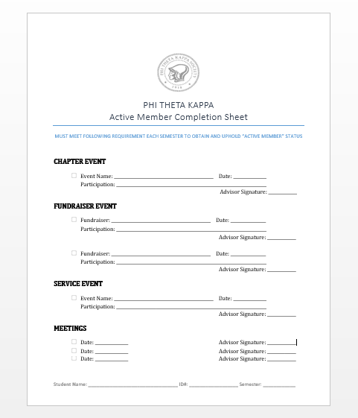
“Active Member” Guidelines
Attend one chapter event
Participate in two fundraiser events
Participate in one service event
Attend three meetings
PER SEMESTER

Slide 6
Membership Benefits
Recognition
Scholarship opportunities
Leadership skills development
A network of fellow scholars
Build academic resume & portfolios
Supply of Phi Theta Kappa graduation regalia*
Travel & attend leadership conferences*
Notes:
Perhaps you saw a little of yourself in the video, so here’s your opportunity see how Phi Theta Kappa membership might change your story.
The benefits of membership include both those that you can see and touch as well as those that come from the Phi Theta Kappa Experience. Here we have grouped the primary benefits into categories to give you a good overview of what’s in store for you as a member.
First is recognition: Phi Theta Kappa wants to recognize your accomplishments as a high-achieving scholar.
Membership can bring you many opportunities to apply for scholarships to help with all stages of your education.
As a member, you’ll have access to tools and experiences to strengthen your leadership skills – and you might even find yourself stepping out of your comfort zone a little.
And, in Phi Theta Kappa, you are not alone. You’ll find a network of support from fellow members, alumni and advisors.

Slide 7
Recognition
Membership pin, certificate
Press release / recommendation letters*
Transcript / diploma seal
Graduation ceremony recognition
*Active Member
Notes:
Approximately 5-7 weeks after your name is reported to Phi Theta Kappa Headquarters, you will receive a packet in the mail with your golden key membership pen, personalized membership certificate, identification card and guide to your benefits as a member – like these (display examples).
As a member you’ll have access to tools on Phi Theta Kappa’s website through which you can request a press release announcing your induction and letters of recommendation confirming your membership in the honor society.
“Phi Theta Kappa Member” will be noted on your transcript, and a Phi Theta Kappa diploma seal will be attached to your diploma when you graduate.*
Also, you can stand out from the crowd during your graduation ceremony by purchasing and wearing Phi Theta Kappa graduation regalia.*
*(Note these are dependent on individual college policy. Confirm this is permitted before including in your presentation.)

Slide 8
Scholarship Opportunities
Nearly $90 million in opportunities
Available at every educational level
Associate degree
Bachelor’s degree
Master’s degree
www.scholarships.ptk.org for scholarships
www.ptk.org for College Fish
Notes:
As a member, you’ll have access to nearly $90 million in scholarship opportunities from Phi Theta Kappa, partnering senior colleges and universities and foundations.
The best thing is that there are scholarship opportunities available for every step of your college career – whether you are working to earn your associate degree or preparing to transfer and pursue a bachelor’s or master’s degree.
In addition, Phi Theta Kappa offers scholarships with special focuses like those to help students who are facing unanticipated financial barriers to completing their degree.
Each scholarship program is different, so I encourage you to go to www.scholarships.ptk.org to check out more of the details.

Slide 9
Leadership Skills Development
Five Star Competitive Edge
Self-paced, professional development plan to build essential leadership skills
Leadership positions
Local
Regional
International
Notes:
Whether your next step after _______ college will be starting a new career or transferring to a four-year college or university, you’ll need more than just good grades to stand out as a leader.
You’ll need skills like professional etiquette, team building, critical thinking and other soft skills to give you the advantage. Phi Theta Kappa calls this the Competitive Edge, and it’s an online program available only to members that can equip you with such skills and even includes an online resume you can share.
There are also opportunities to stretch your leadership skills in a variety of ways, ranging from something as small as volunteering as a committee member to the greater responsibility of serving as a chapter, regional or international officer.

Slide 10
A Network of Scholars
Connect with members
Locally
Regionally
Internationally
Attend leadership conferences*
MS/LA Conference TBA
Nerd Nation April 7-9 in Washington D.C.
Honors Institute June 20-25 in Winston-Salem, NC
Member for life
*Active Member
Notes:
Becoming a member of Phi Theta Kappa connects you with a network of scholars – locally here on our campus, regionally within the ________ region and even on an international level.
Members often say that Phi Theta Kappa feels like a family and that it was the place where they “fit in” and found others like them.
As a member, you choose your level of engagement with the organization.
Our mission is to first recognize your achievement. To receive this recognition you simply accept your invitation.
If you want to connect with our network of scholars, there are lots of opportunities from attending a chapter event, connecting virtually through the internet and social media or even by traveling to a regional or international meeting. The choice is yours.
To maintain your membership while attending _________ College, our only requirement is that you maintain a ______ GPA. When you leave ______________ College as a member in good standing, you remain a member for life. You can continue involvement as an alumni through an alumni association or simply by volunteering at the local, regional or international level as an alumni."

Slide 11
Finish What You Start
91% of Phi Theta Kappa members complete their associate degree and/or transfer to a four-year college or university.
(Based on a study of 14,000 Phi Theta Kappa members nationwide. Compared to the national success rate of 39% among community college students.)
Notes:
We know from experience that Phi Theta Kappa can change your story, but we also have research to back it up!
Research shows that just becoming a Phi Theta Kappa member helps more students finish what they start.
91% of Phi Theta Kappa members complete their associate degree and/or transfer to a four-year college or university.
This is based on a study of 14,000 Phi Theta Kappa members nationwide. Compared to the national success rate of 39% among community college students.

Slide 12
Ready to change your story?
One-time membership fee of $105
Submit in person
Submit online
Notes:
Provide details including
Amount of membership fee = $55 international fee + ___ regional fee + ____ local fee (if any)
Forms of payment accepted
Deadline for submitting application and payment
Where to submit materials on campus? (if collected this way)
How to submit materials online (if collected this way)

Slide 13
Induction Ceremony
April 22, 2016
6:00 PM (Please be present at 5:00 PM)
MGCCC JD Auditorium
Reception to follow
Invite your friends and family
Notes:
Encourage new members to attend the induction ceremony to be honored for their accomplishments.
Provide date, time and location.
Give new inductees an estimate of how long the induction will take and if any type of reception will follow the ceremony.
Encourage new inductees to invite friends and family to attend the ceremony and be part of the celebration of the new member’s achievements.

Slide 14
Questions?
Please contact us through our chapter email or office phone:
Email: omicronalpha.ptk@mgccc.edu
Phone: (228) 897-3943
Facebook: facebook.com/omicronalphaptk
Thank you
Notes:
Allow time for questions at the informational meeting
Post contact information on the slide for those who may have questions later or may not be comfortable asking their questions in the group setting.
Thank them for coming.

